Slide 1
HOW WE CREATED A ‘WINDOW OF OPPORTUNITY’
PUBLIC PERCEPTION ANALYSIS DURING LOCKDOWN:
Lessons for Sustainability
Aarti Khosla
25 May, 20.

Slide 2
HOW WE CREATED A ‘WINDOW OF OPPORTUNITY’
How are people experiencing the lockdown?
What are the big changes in sentiment, esp towards cleaner cities, less traffic and clean air?
What do people feel about WFH?

Slide 3
1082 RESPONDENTS ACROSS 10 CITIES
Gender | Percentage
Males | 60%
Females | 40%
Age
25 – 34 | 59%
35 – 44 | 32%
45 – 55 | 10%
SEC
NCCS A | 80%
NCCS B | 20%
Employment status
Employee | 70%
Self-employed | 30%
Total Base | 1082
Cities | Percentage
Mumbai | 10%
Delhi NCR | 10%
Chennai | 10%
Bangalore | 10%
Hyderabad | 10%
Kolkata | 10%
Jaipur | 10%
Ahmedabad | 10%
Pune | 10%
Surat | 10%
Total Base | 1082

Slide 4
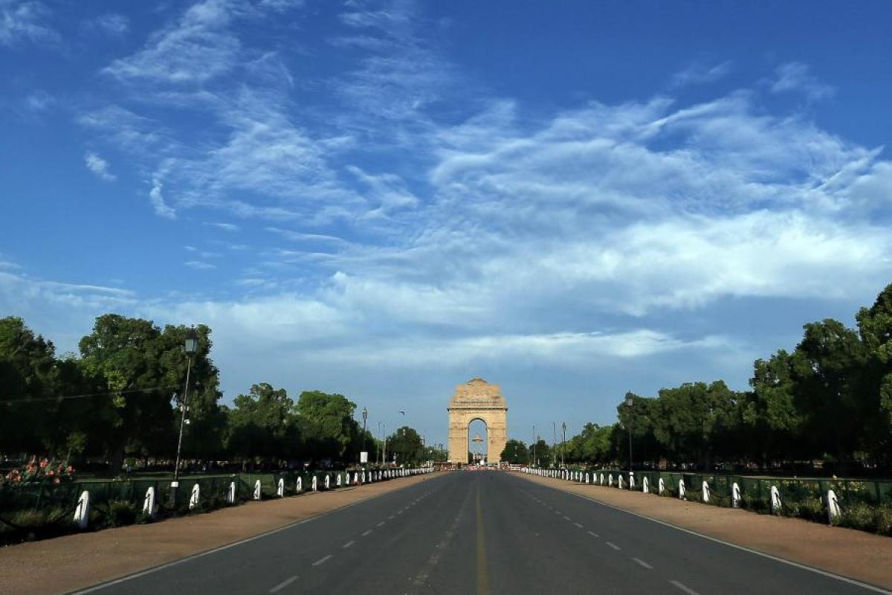
Survey Insights
PRIORITIES- 6 out of 10 people enjoying the time they can spend with family. 9 out of 10 are saving time/money.
CHANGE IN BEHAVIOUR- 7 out of 10 people want to continue working from home if that keeps the city and the air clean.
PERCEPTIONS- 8 out of 10 people believe that WFH and less commute will keep the air cleaner.
IMPACTS- 9 out of 10 people said air pollution impacts them personally( health)
BENEFITS- both practical and environmental

Slide 5
SUMMARY
While these movement restrictions have resulted in lesser pollution, cleaner air, people are also expecting the government to play their part in this maintenance – with a majority (65%) concluding that the government should launch programs that ensure industries go pollution free.
Half of the population identify lack of proper infrastructure at home, irregular routine schedule and reduction in team bonding as their top struggles.
However, in spite of challenges, majority of them (70%) are willing to continue working from home post the lockdown is lifted.
This willingness might be good news for employers who also see benefits of wfh – 9 out of 10 think that their company has saved on operational expense during this time of increased wfh.

Slide 6
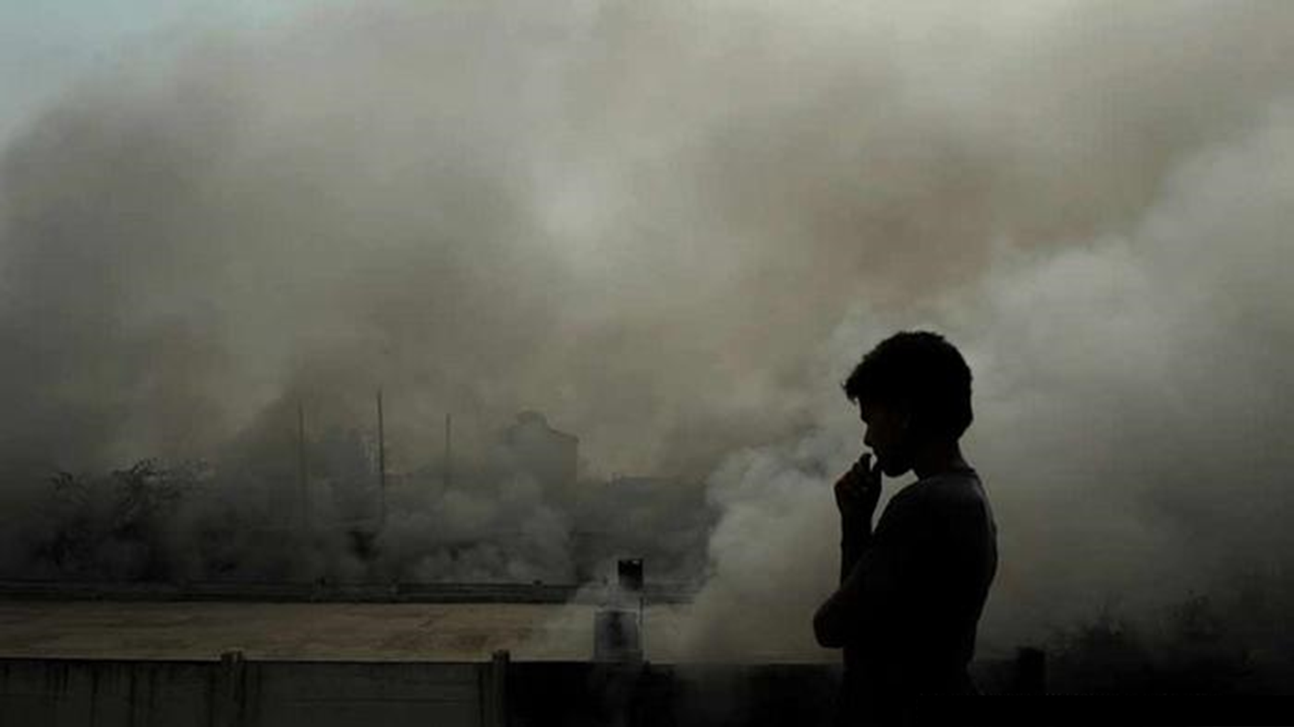
Survey Findings

Slide 7
Indians believe air pollution to be a pervasive problem - more then 90% feel that it impacts them personally.
Evidently, its not just a perception of impact – 1 in 2 also say that they suffer from air pollution related health problems.
Perceived Impact Of Air Pollution
Air Pollution Related Health Problem
Impact of Air pollution is more perceived in Delhi and with the older age group (35 to 44)
Base: 980
Base: 1082
QAP1. To what extent would you say air pollution affects you personally?
QAP2. What air pollution related health problem do you suffer from?
*Top 2 box analysis

Slide 8
Therefore, it is not surprising that Indians would be willing to take steps to maintain this fortuitous reduction in air pollution triggered by the COVID-19 induced lockdown.
Interestingly, fewer people would be willing to take the route of public transport/shared mobility to do so - indicating people wants to maintain social distancing
Measures To Maintain Reduction In Traffic, Pollution Levels
Measures People Are Willing To Take | Overall %
I would consciously choose to walk for shorter distance | 62%
I would demand to work from home as it will reduce congestion from roads and lead to cleaner air | 60%
I would be willing to buy EVs (Electric vehicles) provided the charging infrastructure is in place across the country/in the states around me and prices are made affordable | 49%
I would use shared mobility options for cleaner air and less traffic | 46%
I would consider public transport options more often as it has environmental & health benefits | 41%
I would use public transport for short distance travel | 37%
Average | 49%
Base: 1082
QAP3. The COVID-19 pandemic has led to many people staying in. This has resulted in reduced traffic, lesser pollution and cleaner air. Keeping that in mind, which of the following, if any, would you do to maintain the same? Please select all options that apply.

Slide 9
People are also expecting the government to play their part in this maintenance – with many believing that industries, historically the biggest polluters, should be encouraged to toe the line.
Measures The Government Should Take To Maintain Reduction In Traffic, Pollution Levels
Measures People Want The Government To Take | Overall %
Government should launch a time-bound program for industries who are harmful to environment (e.g. chemical industry, steel and cement industry etc.) to go pollution-free | 65%
Government should focus on restoring the ecological balance (protecting the forests & wildlife) in and around my city | 64%
Government should incentivize buying Electric Vehicles (EVs) | 59%
Government should prioritise funding for more electric public transport | 57%
Government should gradually open up the roads allowing only people to walk and cycle | 57%
Government should move from highly polluting coal power stations and diesel generators to solar, wind and hydropower | 57%
Average | 60%
Base: 1082
QAP4. The COVID-19 pandemic has led to many people staying in. This has resulted in reduced traffic, lesser pollution and cleaner air. Keeping that in mind, which of the following, if any, should the government do to maintain the same? Please select all options that apply.

Slide 10
Overall, people believe that going green via additional parks, eco-friendly transport and industries using clean energy, will have the highest impact on reducing levels of pollution.
Measures To Reduce The Levels Of Pollution
Base: 1082
At an overall level, which of the following, if any, do you think would have the most impact to reduce the levels of pollution?

Slide 11
Survey Findings

Slide 12
And while going green is one way to reduce overall levels of pollution, 8 out of 10 feel that working from home will reduce air pollution in their city
Environmental Benefit Of WFH
Average 72%
Base: 1082
MQ2a. Thinking a little more about advantages, which among the following, if any, do you consider as environmental benefits to working from home? Please select that all apply.

Slide 13
WFH evidently creates a win-win situation practical and environmental benefits
- more time with family and saving money as important as avoiding traffic
Advantages Of WFH
Average 55%
Base: 1082
MQ2. According to you, what are the advantages of working from home? Please select that all apply.

Slide 14
Evidently continued WFH post lockdown is a viable option for many – and most would like to do so to not only avoid traffic, but to enjoy the resultant clean air
WFH the entire month!
Willingness To Continue WFH Post Lockdown
Reasons Of Continuing WFH
Number Of Days Willing To WFH
Males and people form Ahmedabad are more willing to continue WFH post lockdown
Base: 742
Also, people who are currently working in Technology sectors more willing to continue WFH as compared to people who are working in Banking & finance and health & Pharmaceutical sector
Base: 1082
Base: 742
MQ4. Once this lockdown is lifted, would you still like to continue working from home?
MQ5. What are some of the reasons because of which you would still like to continue working from home?
MQ5a.. There are roughly 22 working days in a month, how many days do you think you can work from home and be equally or more productive than when working form office?

Slide 15
But while most people want to WFH, challenges exist – reduced access to work infrastructure, irregular work routine, decreased team bonding top the list for people.
This indicates that along with the practical, the emotional aspect of wellbeing is also on people’s minds when it comes to WFH.
Challenges Of WFH
Average 44%
Base: 1082
MQ3. According to you, what were the challenges you experienced while working from home? Please select all that apply.

Slide 16
And even if some are not immediately ready to continue WFH, a nudge that involves communicating its resultant environmental benefits might influence people’s decision.
Continuing WFH Post Lockdown
Continuing WFH In Benefit Of Environment
Base: 340
Base: 1082
MQ4. Once this lockdown is lifted, would you still like to continue working from home?
MQ6. Many articles theorize that by opting to work from home, there are larger benefits to the society. The air gets cleaner, cities less congested and there is an overall reduction in pollution. In this situation how likely are you to want to work from office?

Slide 17
Employers also see benefits to WFH- 9 out of 10 think that their company has saved on operational expense
…and they would encourage wfh if proper work infrastructure is in place, and productivity is maintained.
Has Company Saved On Operational Expenses Since Employee Was Asked To WFH
Situation In Which Company Will Encourage Employees To WFH
Base: 248
MQ7. As an employer do you think your company saved on operational expenses since employees were asked to work from home?
MQ8. The COVID-19 pandemic has made many industries re-design the way they work. One of the most common ways, has emerged to be ‘work-from-home’.
From the following, in which situation would companies allow/encourage their employees to work from home?

Slide 18
SUMMARY
PEOPLE ARE LIVING THROUGH PARALLEL CRISES AND ARE AWARE OF IT
BRINGING THE WORLD TO A GRINDING HALT WILL BRING 7-8PC DROP IN ANNUAL EMISSIONS- TACKLING CLIMATE CHANGE NEEDS FIXING STRUCTURAL AND SYSTEMIC ISSUES.
PUBLIC PERCEPTIONS HAVE CHANGED. IT WILL TAKE TIME TO CHANGE BEHAVIOUR.
CHANGED PERCEPTION MUST BE SEIZED WISELY FOR A LONGER TERM VIEW OF REDUCING POLLUTION, EMISSIONS, AND STRESS ON OUR RESOURCES. ( POLICY MAKING)
STIMULUS HAS BEEN ANNOUNCED- LET’S NOT WASTE A CRISIS. MAKE IT GREEN!

Slide 19
City level findings

Slide 20
Mumbai
95% of the respondents said they are impacted by air pollution
68% prefer walking shorter distance
65% would demand WFH as it may lead to clean air and less traffic
71% and 70% also want to WFH to avoid crowded places and shared mobility respectively
47% of the respondents willing to buy EVs if the charging infrastructure is in place along with affordability
69% of the total respondents from Mumbai are willing to work from home

Slide 21
Delhi
93% of the respondents said they are impacted by air pollution
61% prefer walking shorter distance
60% would demand WFH as it may lead to clean air and less traffic
65% and 64% also want to WFH to avoid crowded places and shared mobility respectively
56% of the respondents willing to buy EVs if the charging infrastructure is in place along with affordability
70% of the total respondents from Delhi are willing to work from home

Slide 22
Bangalore
92% of the respondents said they are impacted by air pollution
70% prefer walking shorter distance
59% would demand WFH as it may lead to clean air and less traffic
71% of respondents in Bangalore prefer to WFH as it would save money
59% of the respondents willing to buy EVs if the charging infrastructure is in place along with affordability
70% of the total respondents from Bangalore are willing to work from home

Slide 23
Hyderabad
91% of the respondents said they are impacted by air pollution
59% prefer walking shorter distance
57% would demand WFH as it may lead to clean air and less traffic
80% and 67% also want to WFH to avoid crowded places and shared mobility respectively
49% of the respondents willing to buy EVs if the charging infrastructure is in place along with affordability
68% of the total respondents from Hyderabad are willing to work from home

Slide 24
Chennai
90% of the respondents said they are impacted by air pollution
55% prefer walking shorter distance
60% would demand WFH as it may lead to clean air and less traffic
74% and 61% also want to WFH to avoid crowded places and shared mobility respectively
41% of the respondents willing to buy EVs if the charging infrastructure is in place along with affordability
70% of the total respondents from Chennai are willing to work from home

Slide 25
Kolkata
90% of the respondents said they are impacted by air pollution
60% prefer walking shorter distance
60% would demand WFH as it may lead to clean air and less traffic
71% and 72% also want to WFH to avoid crowded places and shared mobility respectively
41% of the respondents willing to buy EVs if the charging infrastructure is in place along with affordability
64% of the total respondents from Kolkata are willing to work from home

Slide 26
Jaipur
94% of the respondents said they are impacted by air pollution
62% prefer walking shorter distance
50% would demand WFH as it may lead to clean air and less traffic
50% of the respondents want to WFH to avoid crowded places and shared mobility respectively
62% of the respondents willing to buy EVs if the charging infrastructure is in place along with affordability (highest among 10 cities)
63% of the total respondents from Jaipur are willing to work from home

Slide 27
Ahmedabad
90% of the respondents said they are impacted by air pollution
62% prefer walking shorter distance
64% would demand WFH as it may lead to clean air and less traffic
64% and 63% also want to WFH to avoid crowded places and shared mobility respectively
43% of the respondents willing to buy EVs if the charging infrastructure is in place along with affordability
78% of the total respondents from Ahmedabad are willing to work from home
(highest amongst the 10 cities)

Slide 28
Pune
93% of the respondents said they are impacted by air pollution
75% prefer walking shorter distance (highest amongst the 10 cities)
71% would demand WFH as it may lead to clean air and less traffic (highest amongst the 10 cities)
80% and 74% also want to WFH to avoid crowded places and shared mobility respectively (highest amongst 10 cities)
57% of the respondents willing to buy EVs if the charging infrastructure is in place along with affordability
69% of the total respondents from Ahmedabad are willing to work from home
(highest amongst the 10 cities)

Slide 29
Surat
78% of the respondents said they are impacted by air pollution (lowest amongst 20 cities)
50% prefer walking shorter distance (highest amongst the 10 cities)
51% would demand WFH as it may lead to clean air and less traffic (highest amongst the 10 cities)
53% and 54% also want to WFH to avoid crowded places and shared mobility respectively (highest amongst 10 cities)
46% of the respondents willing to buy EVs if the charging infrastructure is in place along with affordability
64% of the total respondents from Ahmedabad are willing to work from home
(highest amongst the 10 cities)

Slide 30
Perceived impact of air pollution by cities
Perceived Impact Of Air Pollution | Mumbai | Delhi | Bangalore | Hyderabad | Chennai | Kolkata | Jaipur | Ahmedabad | Pune | Surat | All
Base | 116 | 113 | 118 | 103 | 106 | 112 | 109 | 106 | 106 | 93 | 1082
It affects me a lot | 59% | 62% | 57% | 47% | 48% | 42% | 69% | 53% | 52% | 41% | 53%
It affects me somewhat | 36% | 30% | 35% | 44% | 42% | 48% | 25% | 37% | 41% | 37% | 38%
It does not affect me a lot | 4% | 2% | 5% | 6% | 7% | 6% | 5% | 8% | 5% | 18% | 7%
It does not affect me at all | 1% | 3% | 2% | 1% | 2% | 2% | 0% | 0% | 1% | 4% | 2%
Don't know/can't say | 0% | 3% | 1% | 2% | 1% | 2% | 1% | 2% | 1% | 0% | 1%
Base: 1082
QAP1. To what extent would you say air pollution affects you personally?

Slide 31
Measures people are willing to take by cities
Measures People Are Willing To Take | Mumbai | Delhi | Bangalore | Hyderabad | Chennai | Kolkata | Jaipur | Ahmedabad | Pune | Surat | All
Base | 116 | 113 | 118 | 103 | 106 | 112 | 109 | 106 | 106 | 93 | 1082
I would consciously choose to walk for shorter distance | 68% | 61% | 70% | 59% | 55% | 60% | 62% | 62% | 75% | 50% | 62%
I would demand to work from home as it will reduce congestion from roads and lead to cleaner air | 65% | 60% | 59% | 57% | 60% | 60% | 50% | 64% | 71% | 51% | 60%
I would be willing to buy EVs (Electric vehicles) provided the charging infrastructure is in place across the country/in the states around me and prices are made affordable | 47% | 56% | 50% | 49% | 41% | 41% | 62% | 43% | 57% | 46% | 49%
I would use shared mobility options for cleaner air and less traffic | 45% | 44% | 42% | 47% | 42% | 54% | 45% | 47% | 50% | 48% | 46%
I would consider public transport options more often as it has environmental & health benefits | 52% | 48% | 40% | 36% | 32% | 35% | 49% | 34% | 40% | 40% | 41%
I would use public transport for short distance travel | 41% | 34% | 43% | 41% | 30% | 31% | 40% | 37% | 39% | 29% | 37%
Base: 1082
QAP3. The COVID-19 pandemic has led to many people staying in. This has resulted in reduced traffic, lesser pollution and cleaner air. Keeping that in mind, which of the following, if any, would you do to maintain the same? Please select all options that apply.

Slide 32
Advantages of work from home by cities
Advantages Of WFH | Mumbai | Delhi | Bangalore | Hyderabad | Chennai | Kolkata | Jaipur | Ahmedabad | Pune | Surat | All
Base | 116 | 113 | 118 | 103 | 106 | 112 | 109 | 106 | 106 | 93 | 1082
I can avoid crowds and traffic | 70% | 65% | 67% | 80% | 74% | 71% | 50% | 64% | 80% | 53% | 67%
I can spend more time with my family | 63% | 62% | 63% | 71% | 71% | 71% | 47% | 63% | 69% | 59% | 64%
I can avoid public/shared mobility transportation which have higher infection risks | 71% | 64% | 67% | 67% | 61% | 72% | 50% | 57% | 74% | 54% | 64%
I can save money (e.g. on traveling, ordering food for lunch etc) | 66% | 57% | 71% | 66% | 63% | 61% | 54% | 60% | 74% | 54% | 63%
I can save time because there is no commuting | 66% | 59% | 60% | 65% | 59% | 56% | 50% | 60% | 71% | 46% | 59%
I enjoy the flexibility of my schedule and custom work environment | 62% | 58% | 68% | 52% | 57% | 52% | 50% | 61% | 71% | 57% | 59%
I can wear more comfortable clothes at home | 62% | 63% | 56% | 60% | 67% | 62% | 46% | 60% | 65% | 48% | 59%
I can avoid processed, unhealthy, junk food and eat healthy home food | 61% | 55% | 57% | 60% | 53% | 63% | 50% | 50% | 64% | 52% | 56%
I can attend to my health, fitness regime and personal development needs | 45% | 53% | 50% | 45% | 42% | 55% | 41% | 47% | 57% | 42% | 48%
I don't need to wait for the weekend to finish some personal/household tasks | 46% | 45% | 42% | 50% | 42% | 44% | 32% | 48% | 60% | 35% | 44%
I can avoid long meetings and have shorter, more focused video calls | 44% | 41% | 47% | 40% | 35% | 44% | 41% | 38% | 48% | 34% | 41%
There are no office distractions and my productivity increases | 41% | 40% | 45% | 35% | 32% | 40% | 34% | 37% | 49% | 34% | 39%
Base: 1082
MQ2. According to you, what are the advantages of working from home? Please select that all apply.

Slide 33
Willingness to continue work from home post lockdown by cities
Willingness To Continue WFH Post Lockdown | Mumbai | Delhi | Bangalore | Hyderabad | Chennai | Kolkata | Jaipur | Ahmedabad | Pune | Surat | All
Base | 116 | 113 | 118 | 103 | 106 | 112 | 109 | 106 | 106 | 93 | 1082
Yes, I would still like to work from home | 69% | 70% | 70% | 68% | 70% | 64% | 63% | 78% | 69% | 64% | 69%
No, I would like to go to my office to work | 31% | 30% | 30% | 32% | 30% | 36% | 37% | 22% | 31% | 36% | 31%
Base: 1082
MQ4. Once this lockdown is lifted, would you still like to continue working from home?

Slide 34
Willingness to continue work from home post lockdown by industry
Willingness To Continue WFH Post Lockdown | Aviation | Lifestyle and Fashion | Beauty and Wellness | Education | FMCG and Retail | Hospitality and F&B | Media and Entertainment | Health and Pharmaceuticals | Technology | Banking and Finance | Automotive | Travel and Tourism | Others | All
Base | 10 | 13 | 7 | 123 | 24 | 11 | 32 | 48 | 423 | 137 | 22 | 22 | 210 | 1082
Yes, I would still like to work from home | 91% | 64% | 100% | 69% | 64% | 82% | 78% | 57% | 73% | 61% | 72% | 63% | 64% | 69%
No, I would like to go to my office to work | 9% | 36% | 0% | 31% | 36% | 18% | 22% | 43% | 27% | 39% | 28% | 37% | 36% | 31%
Base: 1082
*Low base
MQ4. Once this lockdown is lifted, would you still like to continue working from home?

