Slide 1
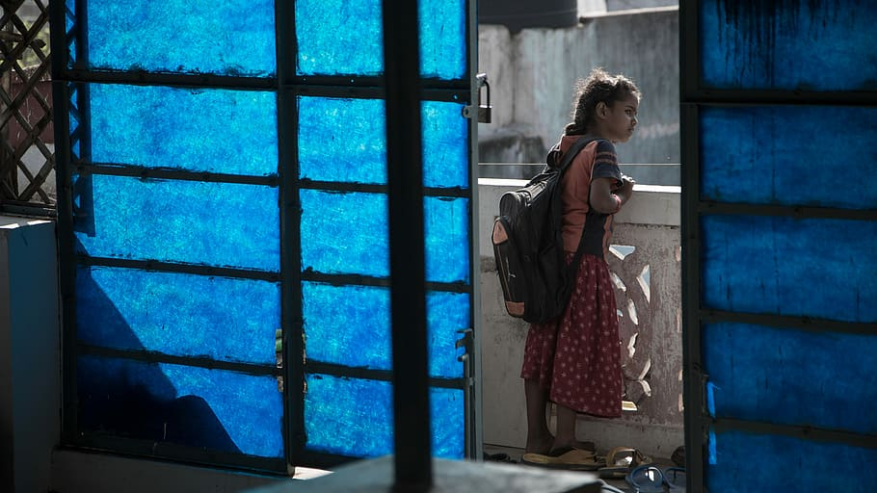
Missing School: Adolescent Girls Marginalised by Growing Divide during Lockdown
Findings of Rapid Assessment in May 2020

Slide 2
Sample
A rapid study was conducted with 290 adolescent girl students from Uttar Pradesh, Tamil Nadu and West Bengal to understand the effects of COVID-19 lockdown

Slide 3
Highlights of the findings: Living Conditions

Slide 4
Highlights of the findings: Impact on Students
More Less Some

Slide 5
Highlights of the findings: Facilities Linked to School

Slide 6
Highlights of the findings: Positives and Negatives

Slide 7
Highlights of the findings: Access to Covid-19 Relief
 | Tamil Nadu | Uttar Pradesh | West Bengal
PDS Provisions | 51 respondents have ration card 3 have able to receive the provisions once, 45 have received twice, and 3 have received thrice. | 196/215, respondents have ration card. 77 have able to receive the provisions once, 82 have received twice, 33 have received thrice, and 4 never received the provisions | Among 24, 21 respondents have ration card All 21 have able to receive the provisions once.
Jan Dhan account | 4 are eligible to receive Rs. 500, 3 have received once and 1 has received twice. | 133 are eligible to receive Rs. 500, 61 have received once, 39 have received twice 32 have never received any amount. | 17 are eligible to receive Rs. 500, 9 have received once, 7 have received twice and 1 has not received any amount.
Old age pension | Totally 11 are eligible, 6 have registered and received the pension | Totally 75 are eligible. 16/ 39 registered have received the pension. | Totally 13 are eligible. 3/ 5 registered have received the pension.
Disability allowance | 5 are eligible 4 have registered – 3 received and 1 not checked the bank account.
Ujawala Scheme | 22 are eligible 21 have received free cylinder | 74 are eligible, 61 have received free cylinder | 13 are eligible, 10 have received free cylinder
Kisan Samman Nidhi | 3 are eligible to receive Rs. 2000, 1 has received | 104 are eligible to receive Rs. 2000, 73 have received

Slide 8
Thank You

